Slide 1
An introduction to Bayesian Networks and the Bayes Net Toolbox for Matlab
Kevin Murphy
MIT AI Lab
19 May 2003

Slide 2
Outline
An introduction to Bayesian networks
An overview of BNT

Slide 3
What is a Bayes (belief) net?
Compact representation of joint probability distributions via conditional independence
Family of Alarm
Qualitative part:
Directed acyclic graph (DAG)
Nodes - random vars.
Edges - direct influence
E
B
P(A | E,B)
Earthquake
Burglary
e
b
0.9
0.1
e
b
0.2
0.8
Radio
Alarm
e
b
0.9
0.1
e
b
0.01
0.99
Call
Together:
Define a unique distribution in a factored form
Quantitative part:
Set of conditional probability distributions
Figure from N. Friedman

Slide 4
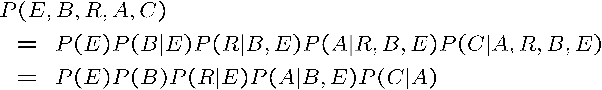
What is a Bayes net?
A node is conditionally independent of its
ancestors given its parents, e.g.
Earthquake
Burglary
C ? R,B,E | A
Hence
Radio
Alarm
Call
From 2⁵ – 1 = 31 parameters to 1+1+2+4+2=10

Slide 5
Why are Bayes nets useful?
- Graph structure supports
  - Modular representation of knowledge
  - Local, distributed algorithms for inference and learning
  - Intuitive (possibly causal) interpretation
- Factored representation may have exponentially fewer parameters than full joint P(X₁,…,X_{n}) =>
  lower sample complexity (less data for learning)
  lower time complexity (less time for inference)

Slide 6
What can Bayes nets be used for?
Posterior probabilities
  Probability of any event given any evidence
Most likely explanation
  Scenario that explains evidence
Rational decision making
  Maximize expected utility
  Value of Information
Effect of intervention
  Causal analysis
Explaining away effect
Earthquake
Burglary
Radio
Radio
Alarm
Call
Call
Figure from N. Friedman

Slide 7
A real Bayes net: Alarm
Domain: Monitoring Intensive-Care Patients
37 variables
509 parameters
…instead of 2³⁷
MINVOLSET
PULMEMBOLUS
INTUBATION
KINKEDTUBE
VENTMACH
DISCONNECT
PAP
SHUNT
VENTLUNG
VENITUBE
PRESS
MINOVL
FIO2
VENTALV
ANAPHYLAXIS
PVSAT
ARTCO2
TPR
SAO2
INSUFFANESTH
EXPCO2
HYPOVOLEMIA
LVFAILURE
CATECHOL
LVEDVOLUME
STROEVOLUME
HISTORY
ERRBLOWOUTPUT
HR
ERRCAUTER
CVP
PCWP
CO
HREKG
HRSAT
HRBP
BP
Figure from N. Friedman

Slide 8
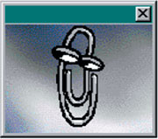
More real-world BN applications
“Microsoft’s competitive advantage lies in its expertise in Bayesian networks”
-- Bill Gates, quoted in LA Times, 1996
MS Answer Wizards, (printer) troubleshooters
Medical diagnosis
Genetic pedigree analysis
Speech recognition (HMMs)
Gene sequence/expression analysis
Turbocodes (channel coding)

Slide 9
Dealing with time
In many systems, data arrives sequentially
Dynamic Bayes nets (DBNs) can be used to model such time-series (sequence) data
Special cases of DBNs include
  State-space models
  Hidden Markov models (HMMs)

Slide 10
State-space model (SSM)/
Linear Dynamical System (LDS)
X₁
X₂
X₃
“True” state
Y₁
Y₃
Noisy observations
Y₂

Slide 11
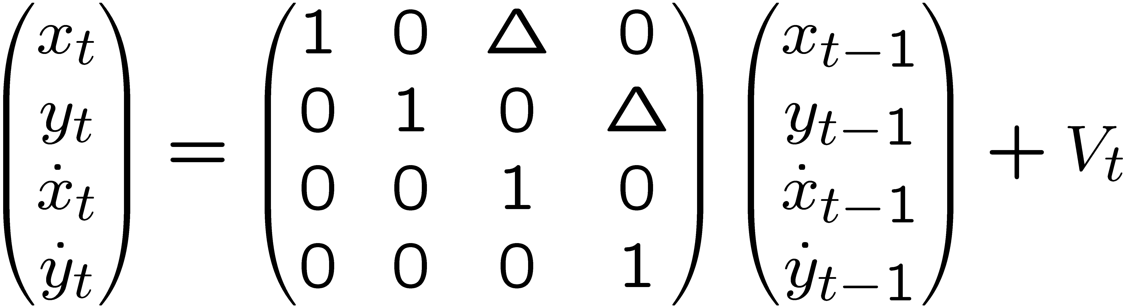
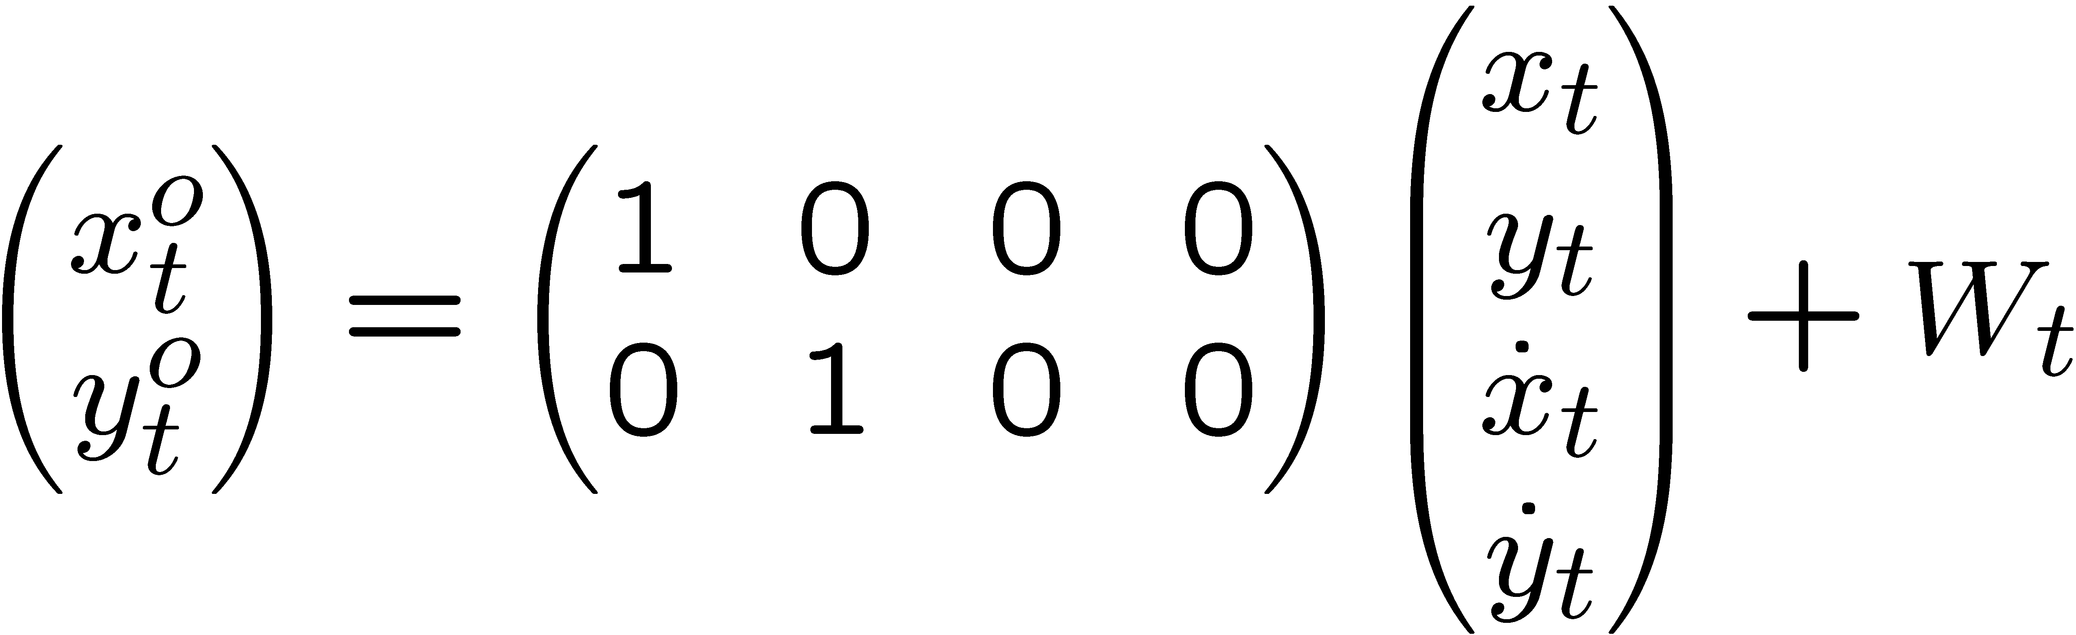
Example: LDS for 2D tracking
Sparse linear Gaussian systems
) sparse graphs
X₁
X₂
X₁
X₂
X₁
X₂
X₃
y₁
y₂
y₁
y₂
Y₁
Y₂
Y₃
o
X₁
o
X₂
o
o
y₁
y₂

Slide 12
Hidden Markov model (HMM)
X₁
X₂
X₃
Phones/ words
Y₁
Y₃
Y₂
acoustic signal
Sparse transition matrix ) sparse graph
transition
matrix
Gaussian
observations

Slide 13
Probabilistic graphical models
Probabilistic models
Graphical models
Directed
Undirected
(Bayesian belief nets)
(Markov nets)
Alarm network
State-space models
HMMs
Naïve Bayes classifier
PCA/ ICA
Markov Random Field
Boltzmann machine
Ising model
Max-ent model
Log-linear models

Slide 14
Toy example of a Markov net
X₁
X₂
X₃
X₄
X₅
X_{i} ? X_{rest} | X_{nbrs}
e.g, X₁ ? X₄, X₅ | X₂, X₃
Potential functions
Partition function

Slide 15
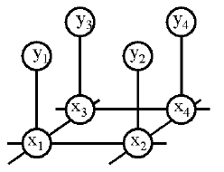
A real Markov net
Observed pixels
Latent causes
Estimate P(x₁, …, x_{n} | y₁, …, y_{n})
Ψ(x_{i}, y_{i}) = P(observe y_{i} | x_{i}): local evidence
Ψ(x_{i}, x_{j}) / exp(-J(x_{i}, x_{j})): compatibility matrix
c.f., Ising/Potts model

Slide 16
Inference
Posterior probabilities
  Probability of any event given any evidence
Most likely explanation
  Scenario that explains evidence
Rational decision making
  Maximize expected utility
  Value of Information
Effect of intervention
  Causal analysis
Explaining away effect
Earthquake
Burglary
Radio
Radio
Alarm
Call
Call
Figure from N. Friedman

Slide 17
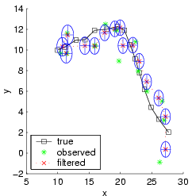
Kalman filtering (recursive state estimation in an LDS)
X₁
X₂
X₃
Y₁
Y₂
Y₃
Estimate P(X_{t}|y_{1:t}) from P(X_{t-1}|y_{1:t-1}) and y_{t}
Predict: P(X_{t}|y_{1:t-1}) = s_{Xt-1} P(X_{t}|X_{t-1}) P(X_{t-1}|y_{1:t-1})
Update: P(X_{t}|y_{1:t}) / P(y_{t}|X_{t}) P(X_{t}|y_{1:t-1})

Slide 18
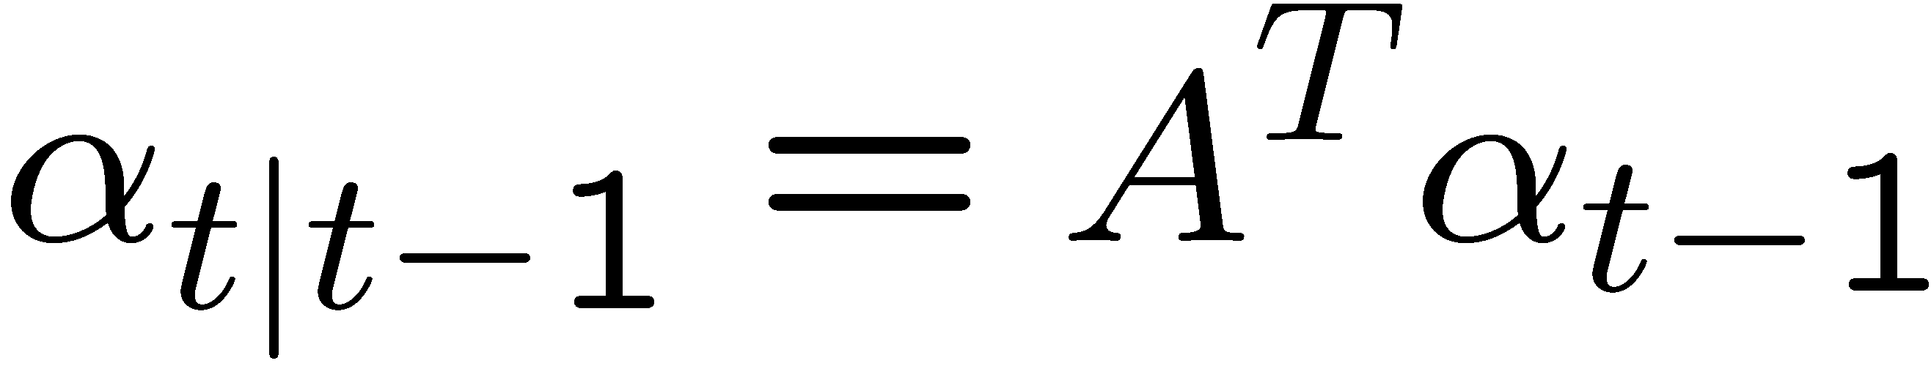
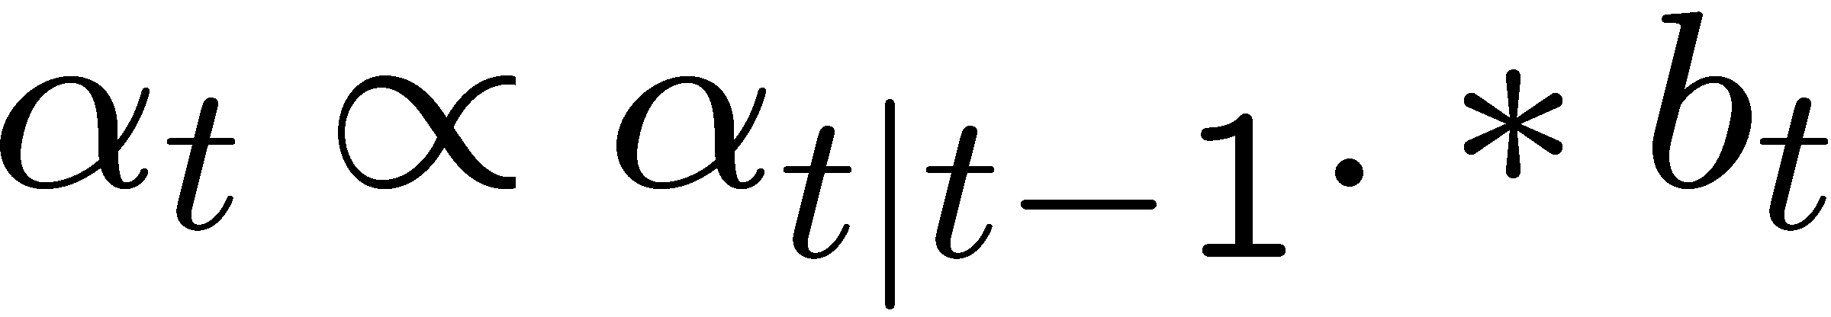
Forwards algorithm for HMMs
Predict:
Update:
Discrete-state analog of Kalman filter
O(T S²) time using dynamic programming

Slide 19
Message passing view of forwards algorithm
α_{t|t-1}
X_{t-1}
X_{t}
X_{t+1}
b_{t}
b_{t+1}
Y_{t-1}
Y_{t+1}
Y_{t}

Slide 20
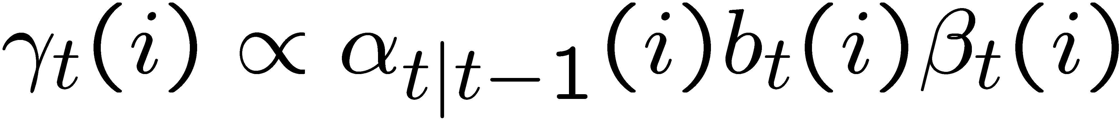
Forwards-backwards algorithm
α_{t|t-1}
β_{t}
X_{t-1}
X_{t}
X_{t+1}
b_{t}
Y_{t-1}
Y_{t+1}
Y_{t}
Discrete analog of RTS smoother

Slide 21
Belief Propagation
aka Pearl’s algorithm, sum-product algorithm
Generalization of forwards-backwards algo. /RTS smoother
from chains to trees - linear time, two-pass algorithm
Collect
Distribute
root
root
root
root
Figure from P. Green

Slide 22
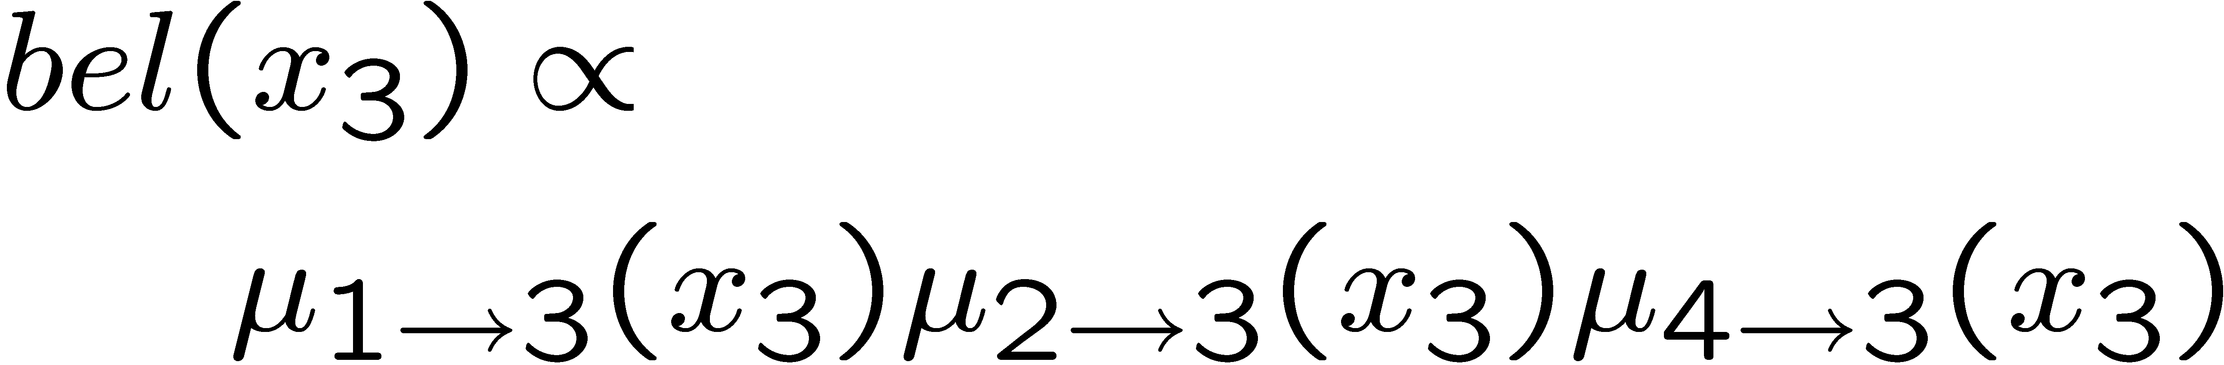
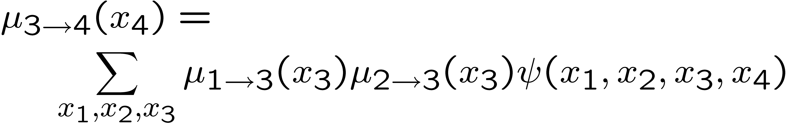
BP: parallel, distributed version
X₁
Stage 1.
Stage 2.
X₁
X₃
X₄
X₃
X₄
X₂
X₂

Slide 23
Representing potentials
For discrete variables, potentials can be represented as multi-dimensional arrays (vectors for single node potentials)
For jointly Gaussian variables, we can use
ψ(X) = (μ, Σ) or ψ(X) = (Σ⁻¹ μ ,Σ⁻¹)
In general, we can use mixtures of Gaussians or non-parametric forms

Slide 24
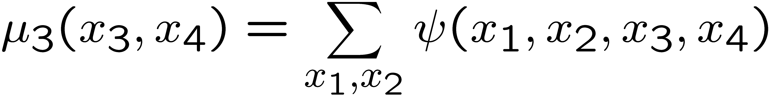
Manipulating discrete potentials
Marginalization
Multiplication
80% of time is spent manipulating such multi-dimensional arrays!

Slide 25
Manipulating Gaussian potentials
Closed-form formulae for marginalization and multiplication
O(1)/O(n³) complexity per operation
Mixtures of Gaussian potentials are not closed under marginalization, so need approximations (moment matching)

Slide 26
Semi-rings
By redefining * and +, same code implements Kalman filter and forwards algorithm
By replacing + with max, can convert from forwards (sum-product) to Viterbi algorithm (max-product)
BP works on any commutative semi-ring!

Slide 27
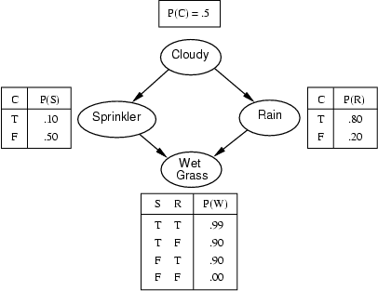
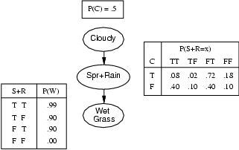
Inference in general graphs
BP is only guaranteed to be correct for trees
A general graph should be converted to a junction tree, by clustering nodes
Computationally complexity is exponential in size of the resulting clusters (NP-hard)

Slide 28
Approximate inference
Why?
  to avoid exponential complexity of exact inference in discrete loopy graphs
  Because cannot compute messages in closed form (even for trees) in the non-linear/non-Gaussian case
How?
  Deterministic approximations: loopy BP, mean field, structured variational, etc
  Stochastic approximations: MCMC (Gibbs sampling), likelihood weighting, particle filtering, etc
- Algorithms make different speed/accuracy tradeoffs
- Should provide the user with a choice of algorithms

Slide 29
Learning
Parameter estimation
Model selection (structure learning)

Slide 30
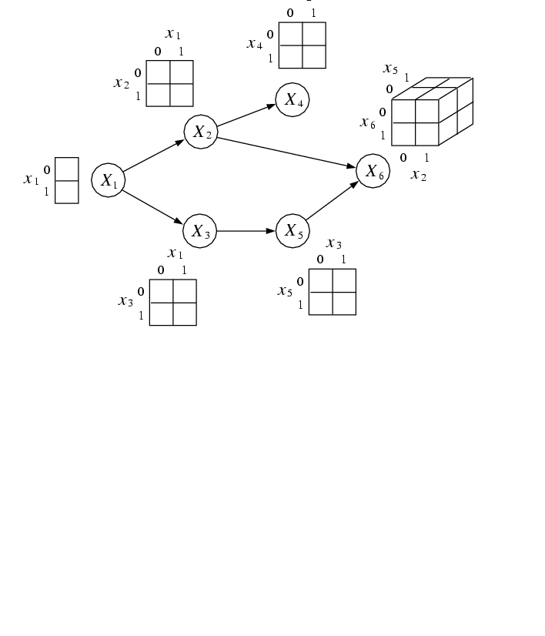
Parameter learning
iid data
Conditional Probability Tables (CPTs)
X₁ | X₂ | X₃ | X₄ | X₅ | X₆
0 | 1 | 0 | 0 | 0 | 0
1 | ? | 1 | 1 | ? | 1
 |  | …
1 | 1 | 1 | 0 | 1 | 1
If some values are missing
(latent variables), we must use
gradient descent or EM to compute the
(locally) maximum likelihood estimates
Figure from M. Jordan

Slide 31
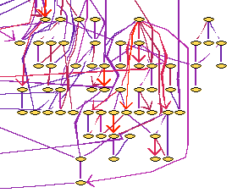
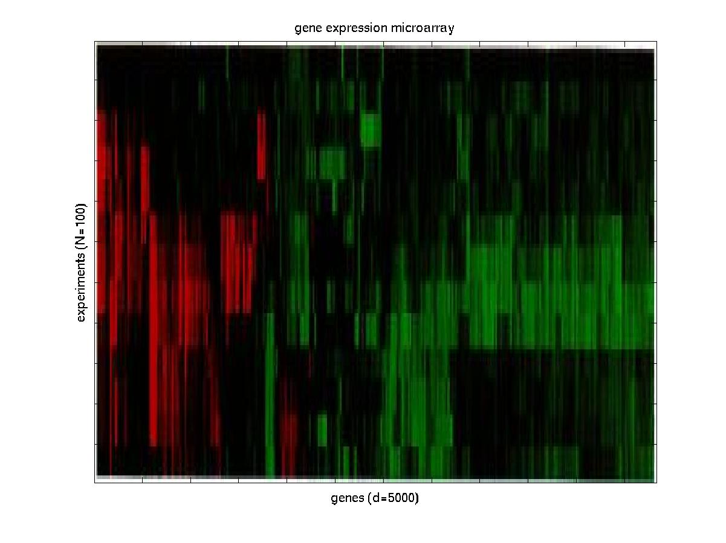
Structure learning (data mining)
Genetic pathway
Gene expression data
Figure from N. Friedman

Slide 32
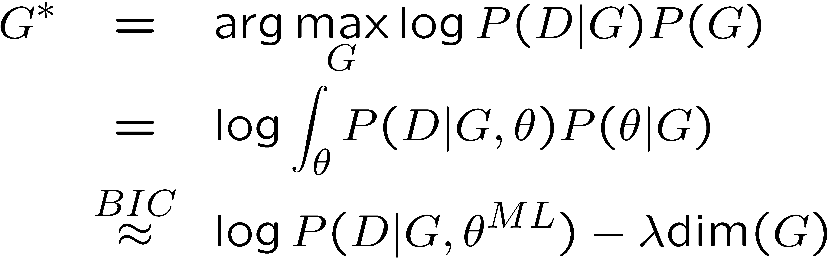
Structure learning
Learning the optimal structure is NP-hard (except for trees)
Hence use heuristic search through space of DAGs or
PDAGs or node orderings
Search algorithms: hill climbing, simulated annealing, GAs
Scoring function is often marginal likelihood, or an
approximation like BIC/MDL or AIC
Structural complexity penalty

Slide 33
Summary: why are graphical models useful?
- Factored representation may have exponentially fewer parameters than full joint P(X₁,…,X_{n}) =>
  lower time complexity (less time for inference)
  lower sample complexity (less data for learning)
- Graph structure supports
  Modular representation of knowledge
  Local, distributed algorithms for inference and learning
  Intuitive (possibly causal) interpretation

Slide 34
The Bayes Net Toolbox for Matlab
What is BNT?
Why yet another BN toolbox?
Why Matlab?
An overview of BNT’s design
How to use BNT
Other GM projects

Slide 35
What is BNT?
BNT is an open-source collection of matlab functions for inference and learning of (directed) graphical models
Started in Summer 1997 (DEC CRL), development continued while at UCB
Over 100,000 hits and about 30,000 downloads since May 2000
About 43,000 lines of code (of which 8,000 are comments)

Slide 36
Why yet another BN toolbox?
In 1997, there were very few BN programs, and all failed to satisfy the following desiderata:
  Must support real-valued (vector) data
  Must support learning (params and struct)
  Must support time series
  Must support exact and approximate inference
  Must separate API from UI
  Must support MRFs as well as BNs
  Must be possible to add new models and algorithms
  Preferably free
  Preferably open-source
  Preferably easy to read/ modify
  Preferably fast
BNT meets all these criteria except for the last

Slide 37
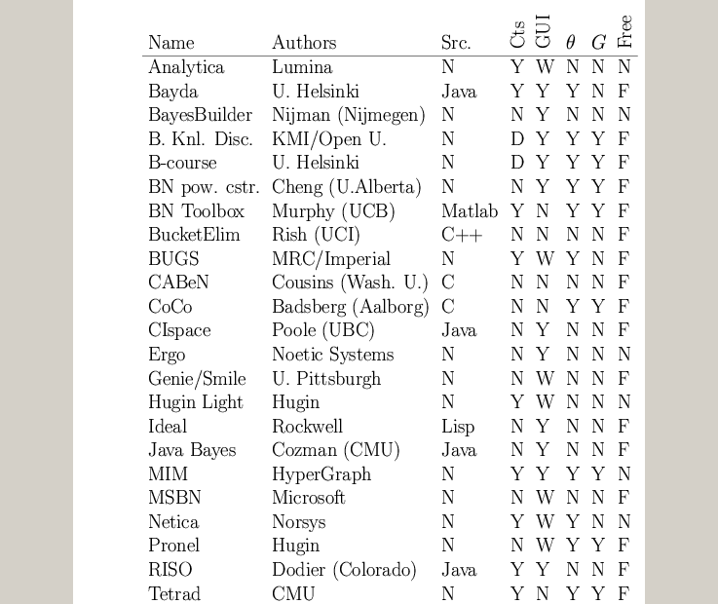
A comparison of GM software
www.ai.mit.edu/~murphyk/Software/Bayes/bnsoft.html

Slide 38
Summary of existing GM software
~8 commercial products (Analytica, BayesiaLab, Bayesware, Business Navigator, Ergo, Hugin, MIM, Netica), focused on data mining and decision support; most have free “student” versions
~30 academic programs, of which ~20 have source code (mostly Java, some C++/ Lisp)
Most focus on exact inference in discrete, static, directed graphs (notable exceptions: BUGS and VIBES)
Many have nice GUIs and database support
BNT contains more features than most of these packages combined!

Slide 39
Why Matlab?
Pros
  Excellent interactive development environment
  Excellent numerical algorithms (e.g., SVD)
  Excellent data visualization
  Many other toolboxes, e.g., netlab
  Code is high-level and easy to read (e.g., Kalman filter in 5 lines of code)
  Matlab is the lingua franca of engineers and NIPS
Cons:
  Slow
  Commercial license is expensive
  Poor support for complex data structures
Other languages I would consider in hindsight:
  Lush, R, Ocaml, Numpy, Lisp, Java

Slide 40
BNT’s class structure
Models – bnet, mnet, DBN, factor graph, influence (decision) diagram
CPDs – Gaussian, tabular, softmax, etc
Potentials – discrete, Gaussian, mixed
Inference engines
  Exact - junction tree, variable elimination
  Approximate - (loopy) belief propagation, sampling
Learning engines
  Parameters – EM, (conjugate gradient)
  Structure - MCMC over graphs, K2

Slide 41
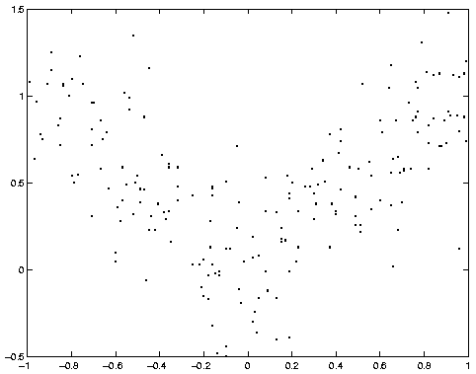
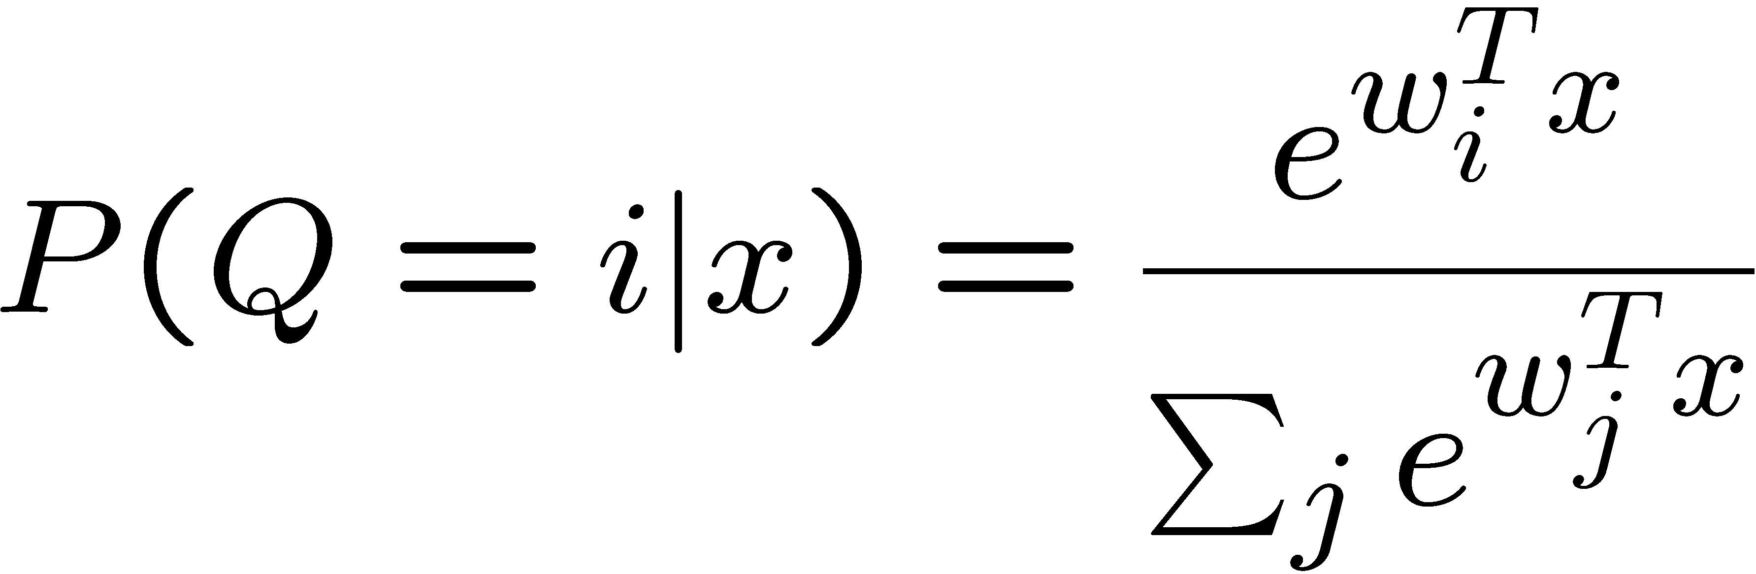
Example: mixture of experts
X
Q
Y
softmax/logistic function

Slide 42
1. Making the graph
X = 1; Q = 2; Y = 3;
dag = zeros(3,3);
dag(X, [Q Y]) = 1;
dag(Q, Y) = 1;
X
Q
Graphs are (sparse) adjacency matrices
GUI would be useful for creating complex graphs
Repetitive graph structure (e.g., chains, grids) is best
created using a script (as above)
Y

Slide 43
2. Making the model
X
node_sizes = [1 2 1];
dnodes = [2];
bnet = mk_bnet(dag, node_sizes, …
‘discrete’, dnodes);
Q
X is always observed input, hence only one effective value
Q is a hidden binary node
Y is a hidden scalar node
bnet is a struct, but should be an object
mk_bnet has many optional arguments, passed as string/value pairs
Y

Slide 44
3. Specifying the parameters
X
bnet.CPD{X} = root_CPD(bnet, X);
bnet.CPD{Q} = softmax_CPD(bnet, Q);
bnet.CPD{Y} = gaussian_CPD(bnet, Y);
Q
CPDs are objects which support various methods such as
  Convert_from_CPD_to_potential
  Maximize_params_given_expected_suff_stats
Each CPD is created with random parameters
Each CPD constructor has many optional arguments
Y

Slide 45
4. Training the model
X
load data –ascii;
ncases = size(data, 1);
cases = cell(3, ncases);
observed = [X Y];
cases(observed, :) = num2cell(data’);
Q
Y
Training data is stored in cell arrays (slow!), to allow for
variable-sized nodes and missing values
cases{i,t} = value of node i in case t
engine = jtree_inf_engine(bnet, observed);
Any inference engine could be used for this trivial model
bnet2 = learn_params_em(engine, cases);
We use EM since the Q nodes are hidden during training
learn_params_em is a function, but should be an object

Slide 46
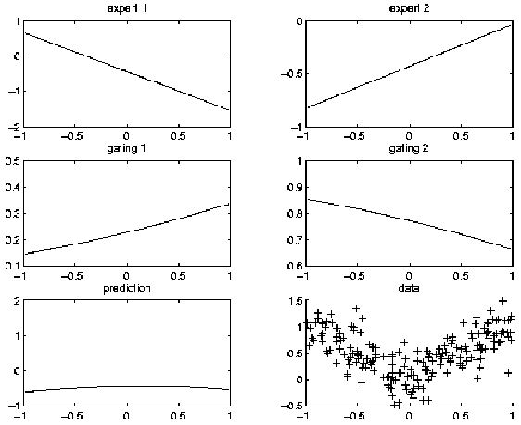
Before training

Slide 47
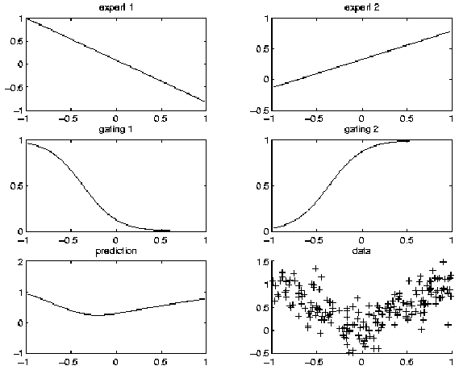
After training

Slide 48
5. Inference/ prediction
engine = jtree_inf_engine(bnet2);
evidence = cell(1,3);
evidence{X} = 0.68; % Q and Y are hidden
engine = enter_evidence(engine, evidence);
m = marginal_nodes(engine, Y);
m.mu % E[Y|X]
m.Sigma % Cov[Y|X]
X
Q
Y

Slide 49
Other kinds of models that BNT supports
Classification/ regression: linear regression, logistic regression, cluster weighted regression, hierarchical mixtures of experts, naïve Bayes
Dimensionality reduction: probabilistic PCA, factor analysis, probabilistic ICA
Density estimation: mixtures of Gaussians
State-space models: LDS, switching LDS, tree-structured AR models
HMM variants: input-output HMM, factorial HMM, coupled HMM, DBNs
Probabilistic expert systems: QMR, Alarm, etc.
Limited-memory influence diagrams (LIMID)
Undirected graphical models (MRFs)

Slide 50
Summary of BNT
Provides many different kinds of models/ CPDs – lego brick philosophy
Provides many inference algorithms, with different speed/ accuracy/ generality tradeoffs (to be chosen by user)
Provides several learning algorithms (parameters and structure)
Source code is easy to read and extend

Slide 51
What is wrong with BNT?
It is slow
It has little support for undirected models
Models are not bona fide objects
Learning engines are not objects
It does not support online inference/learning
It does not support Bayesian estimation
It has no GUI
It has no file parser
It is more complex than necessary

Slide 52
Some alternatives to BNT?
HUGIN: commercial
  Junction tree inference only, no support for DBNs
PNL: Probabilistic Networks Library (Intel)
  Open-source C++, based on BNT, work in progress (due 12/03)
GMTk: Graphical Models toolkit (Bilmes, Zweig/ UW)
  Open source C++, designed for ASR (HTK), binary avail now
AutoBayes: code generator (Fischer, Buntine/NASA Ames)
  Prolog generates matlab/C, not avail. to public
VIBES: variational inference (Winn / Bishop, U. Cambridge)
  conjugate exponential models, work in progress
BUGS: (Spiegelhalter et al., MRC UK)
  Gibbs sampling for Bayesian DAGs, binary avail. since ’96

Slide 53
Why yet another GM toolbox?
In 2003, there are still very few GM programs that satisfy the following desiderata:
  Must support real-valued (vector) data
  Must support learning (params and struct)
  Must support time series
  Must support exact and approximate inference
  Must separate API from UI
  Must support MRFs as well as BNs
  Must be possible to add new models and algorithms
  Preferably free
  Preferably open-source
  Must be easy to read/ modify
  Must be fast (smarter algorithms, not better coding!)
  Must be integrated with data analysis environment

